Slide 1
SMART EDUCATION TRACK
Presented By :-
Bezerk Coder

Slide 2
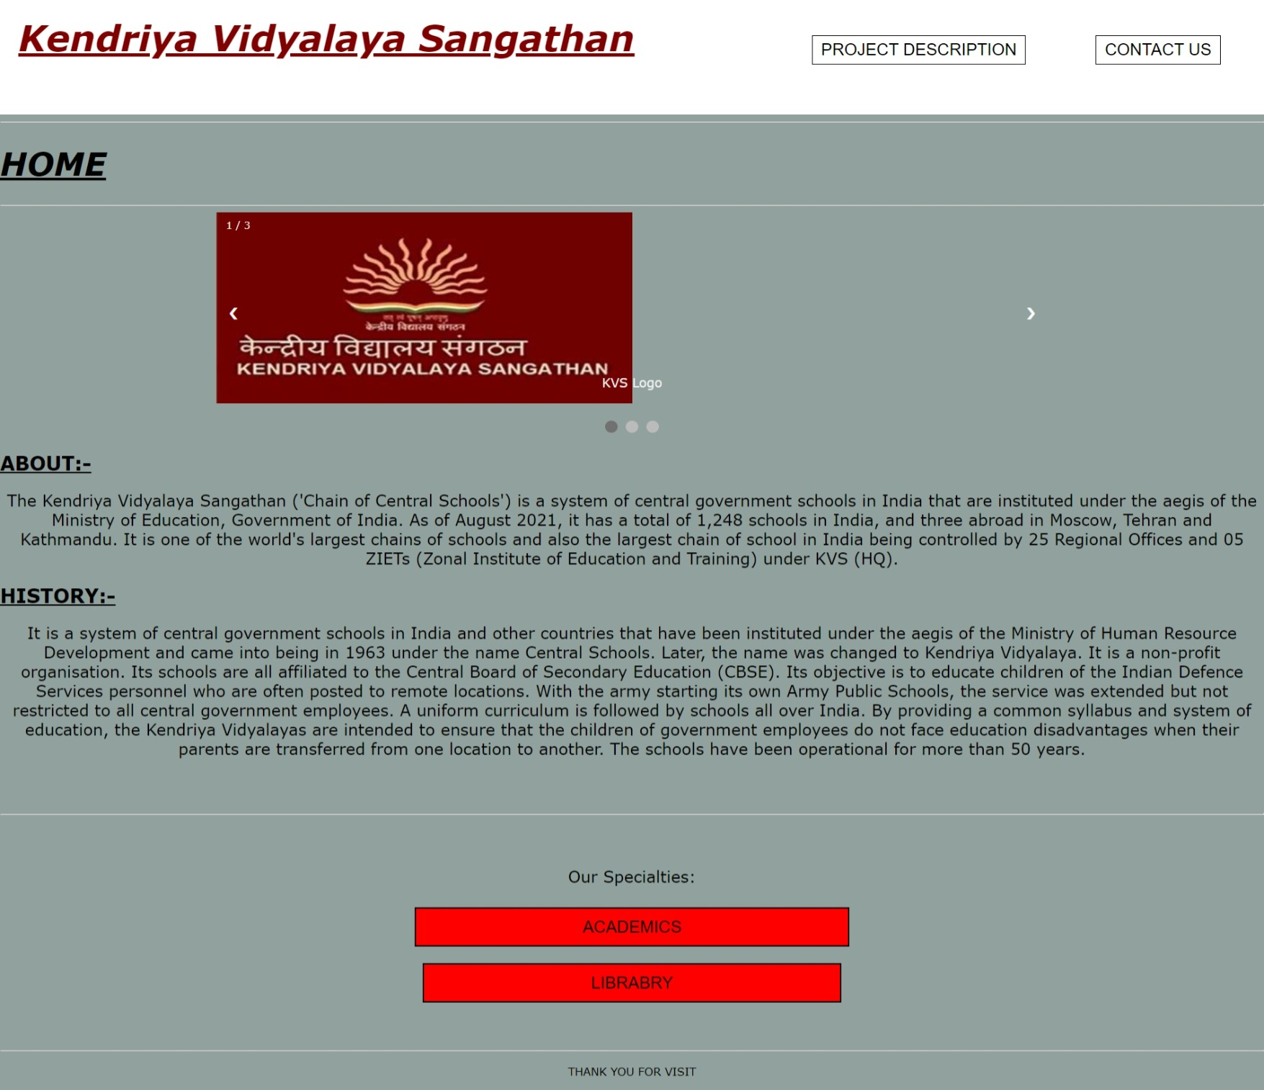
We are representing KVS as our dummy school site
This is our website which represents that how we can develop some new methodes to help the students more in this covid pandemic situation.

Slide 3
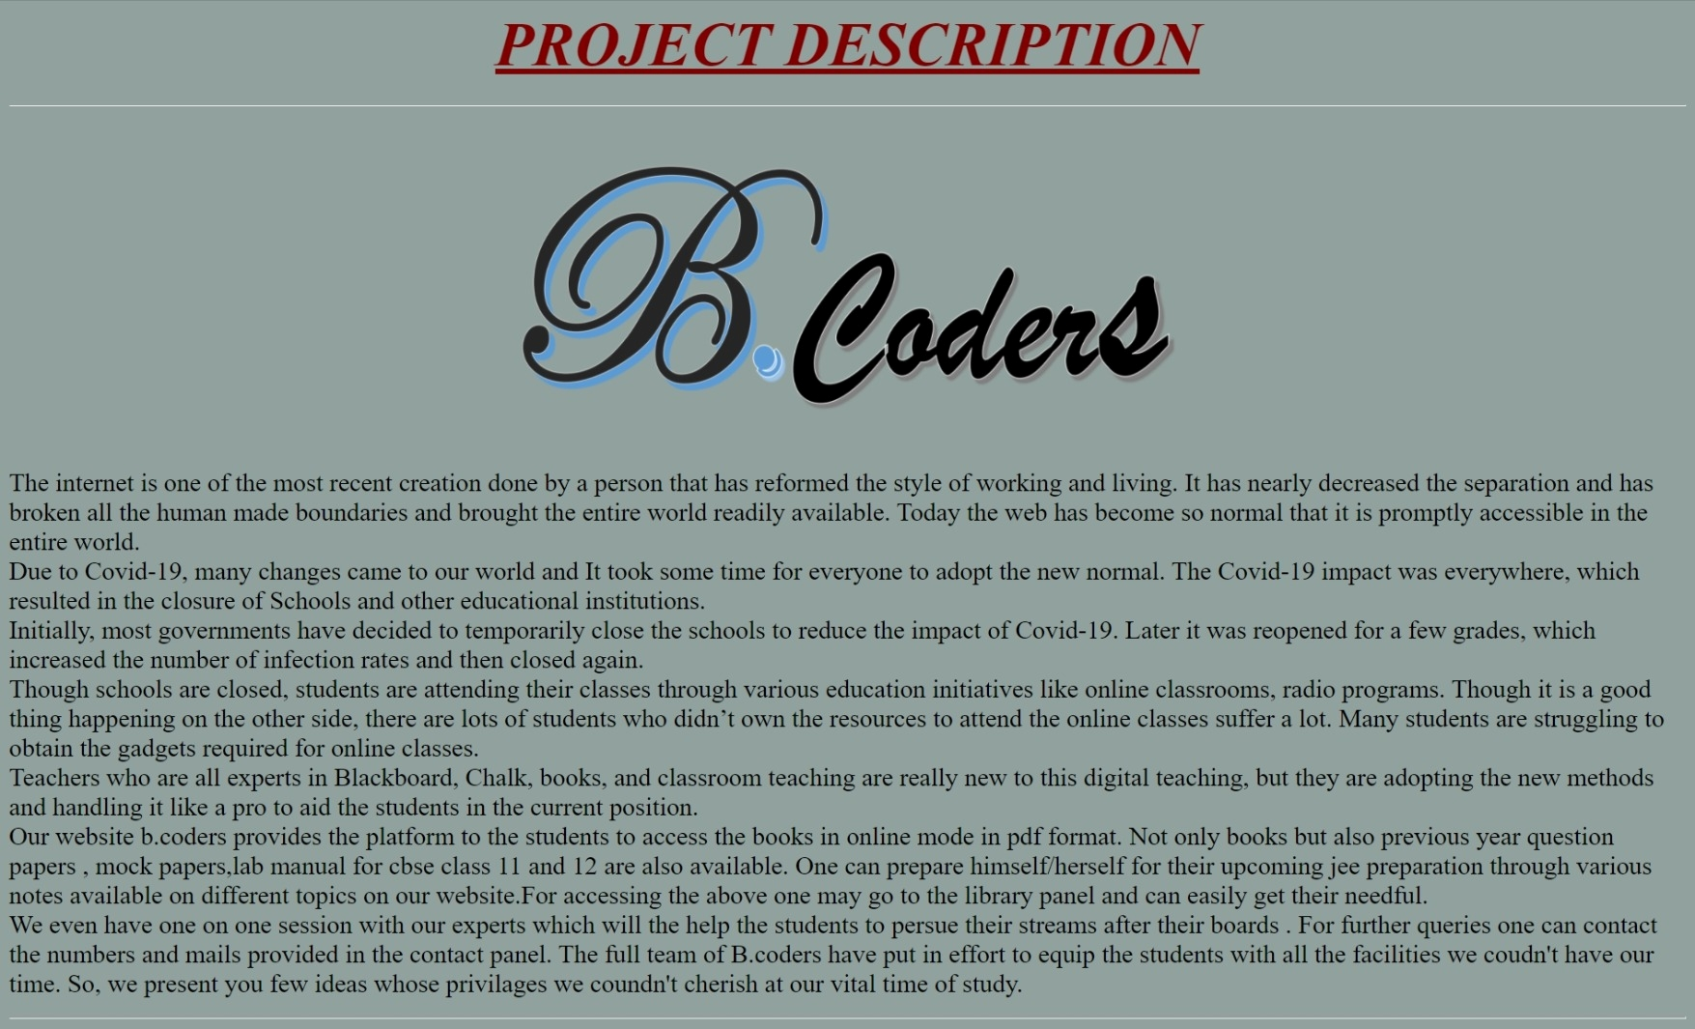
Project Description
This a little description that how we made this website and the names of the members who put in effort to creat this website with their respective field of effort.

Slide 4
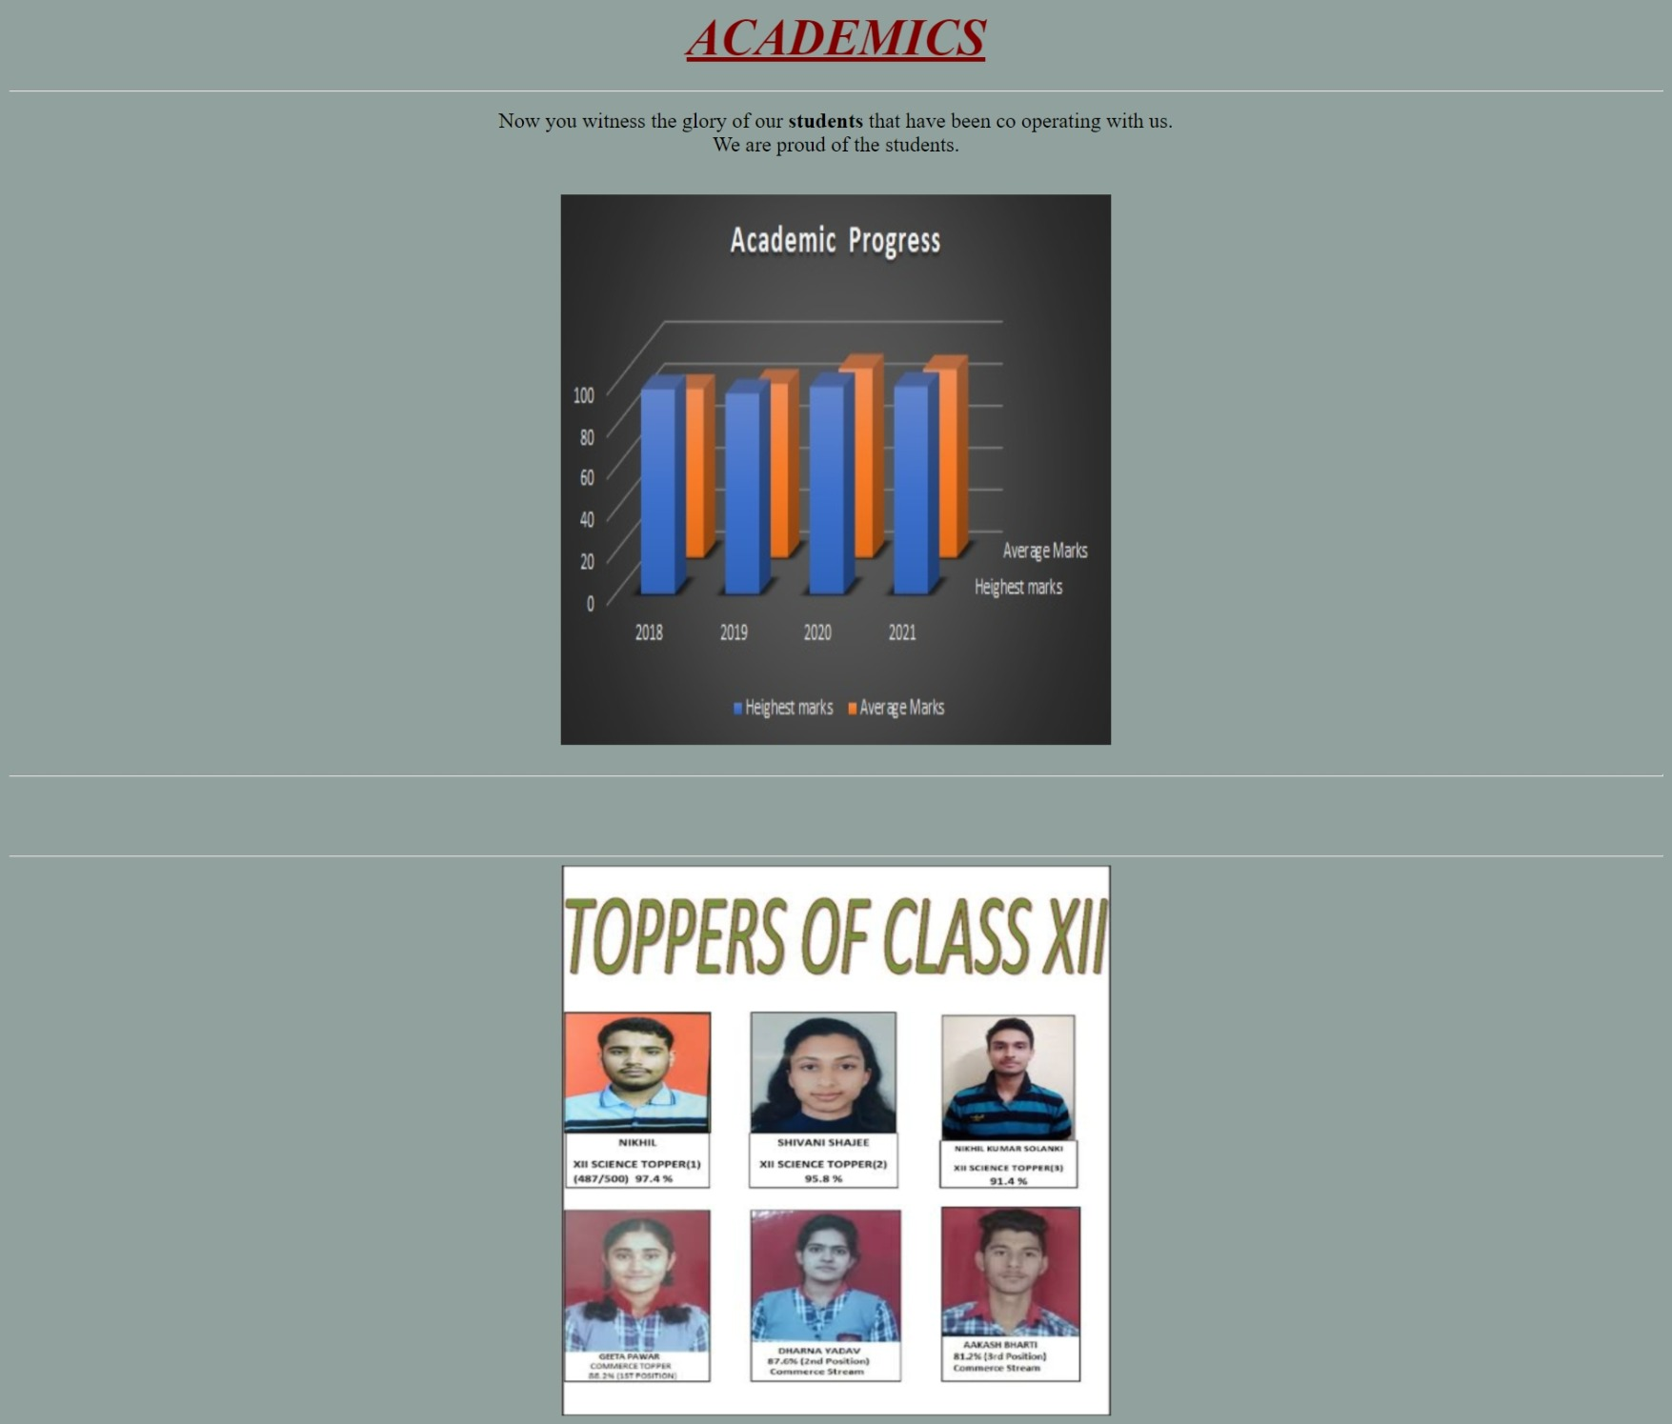
Academics
In the academics we have the records of academic progress and the detail of the students who stands out from the avgerage.

Slide 5
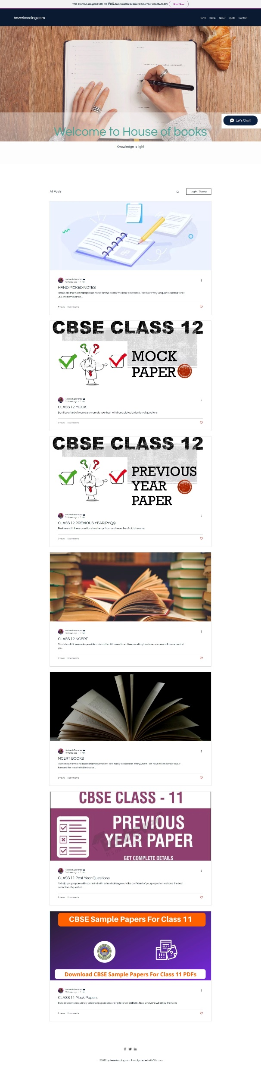
Library
The main speciality of our website is LIBRARY.
Our website b.coders provides the platform to the students to access the books in online mode in pdf format. Not only books but also previous year question papers , mock papers , lab manual for CBSE class 11 and 12 are also available. One can prepare himself/herself for their upcoming JEE preparation through various notes available on different topics on our website.

Slide 6
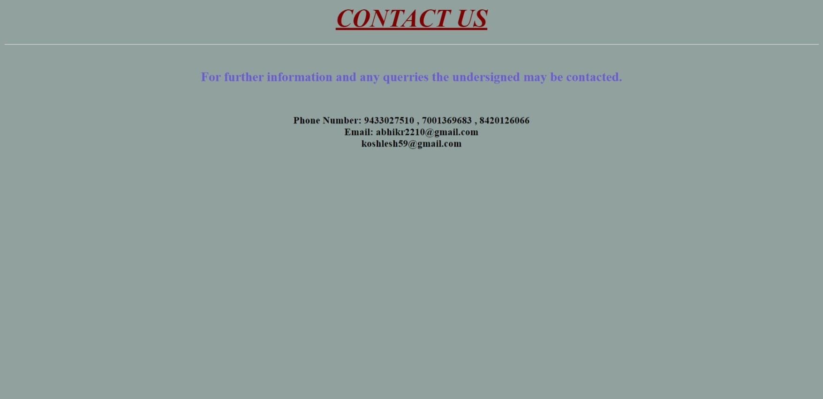
Contact Details

Slide 7
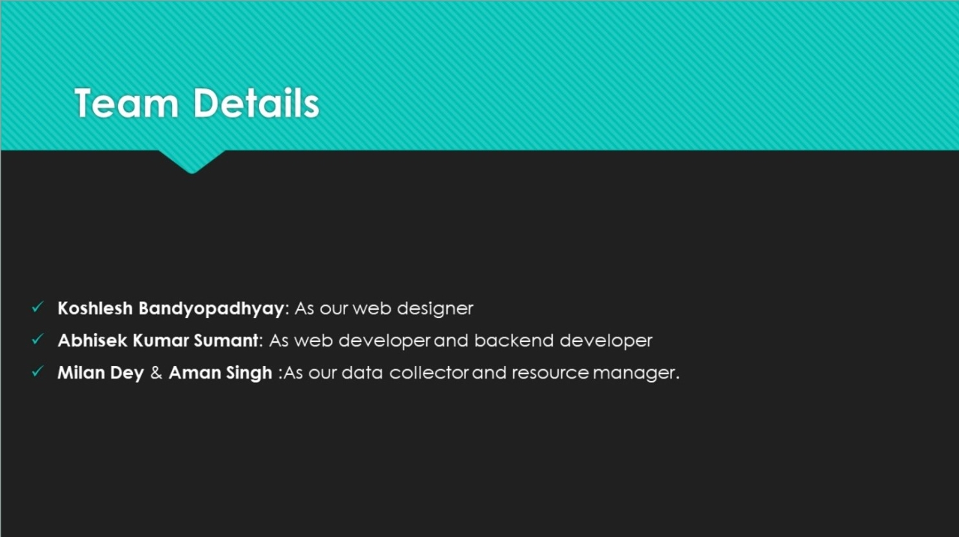
Credit

Slide 8
Thank You

